Slide 1
CI/CD for NodeJS App in AWS
Viachaslau Mikhalenka, DOS15-onl / DevOps

Slide 2
Introduction
This thesis project aims to demonstrate the seamless assembly and deployment of a React + NodeJS application interacting with PostgreSQL. Leveraging Terraform on AWS, a network infrastructure was configured, comprising two EC2 instances designated for Jenkins Master and Jenkins Agent. Additionally, Security Groups were established to secure the instances. The project includes the development of a Jenkins Pipeline, orchestrating the build and deployment processes of the application into a K8s minikube cluster.

Slide 3
Project Objectives
Build Process: Implement an efficient build process for the React + NodeJS application.
AWS Infrastructure: Utilize Terraform to set up a network infrastructure on AWS, including the creation of EC2 instances for Jenkins Master and Jenkins Agent.
Security Measures: Configure Security Groups to ensure the secure operation of the Jenkins instances.
Pipeline Automation: Develop a Jenkins Pipeline to automate the build and deployment processes.
Kubernetes Deployment: Deploy the application into a K8s minikube cluster for testing and validation.

Slide 4
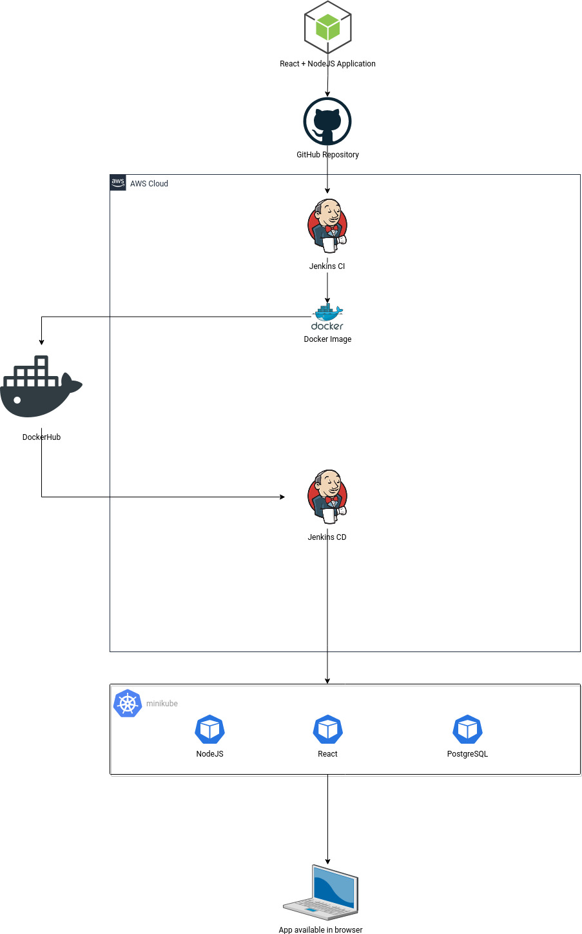

Slide 5
Technologies Used
Frontend: React
Backend: NodeJS
Database: PostgreSQL
Infrastructure as Code (IaC): Terraform
Continuous Integration/Continuous Deployment (CI/CD): Jenkins
Container Orchestration: Kubernetes (minikube)
Cloud Provider: Amazon Web Services (AWS)

Slide 6
Project Structure
1. AWS Infrastructure Setup
Network configuration with Terraform.
Creation of EC2 instances for Jenkins Master and Jenkins Agent.
Security Groups for secure communication.
2. Jenkins Pipeline
Automated build and deployment processes.
3. React + NodeJS Application
Frontend developed in React.
Backend powered by NodeJS.
Interaction with a PostgreSQL database.
4. Kubernetes Deployment
Application deployment into a K8s minikube cluster.

Slide 7
module "network" {
source = "./modules/network"
vpc_name = "dos-15-mikhalenka-vpc"
vpc_cidr = "10.0.0.0/16"
availability_zones = ["us-east-1a"]
public_subnet_cidrs = ["10.0.1.0/24"]
private_subnet_cidrs = ["10.0.2.0/24"]
enable_dns_hostnames = true
enable_dns_support = true
}
module "jenkins_master_sg" {
source = "./modules/security"
name = "dos_15_mikhalenka_jenkins_master_sg"
description = "Security Group for Jenkins Master."
vpc_id = module.network.vpc_id
ingress_ports = [
{ from_port = 57385, to_port = 57385 },
{ from_port = 57386, to_port = 57386 }
]
ingress_protocol = "tcp"
ingress_cidr_blocks = ["0.0.0.0/0"]
egress_from_port = 0
egress_to_port = 0
egress_protocol = "-1"
egress_cidr_blocks = ["0.0.0.0/0"]
}
module "jenkins_master" {
source = "./modules/compute"
name = "dos_15_mikhalenka_jenkins_master"
instance_type = "t2.micro"
key_name = "DOS_15_Mikhalenka"
subnet_id = element(module.network.public_subnet_ids, 0)
security_group_id = module.jenkins_master_sg.security_group_id
volume_size = 8
volume_type = "gp2"
associate_public_ip_address = true
user_data = "${file("./modules/compute/scripts/jenkins_install.sh")}"
}

Slide 8
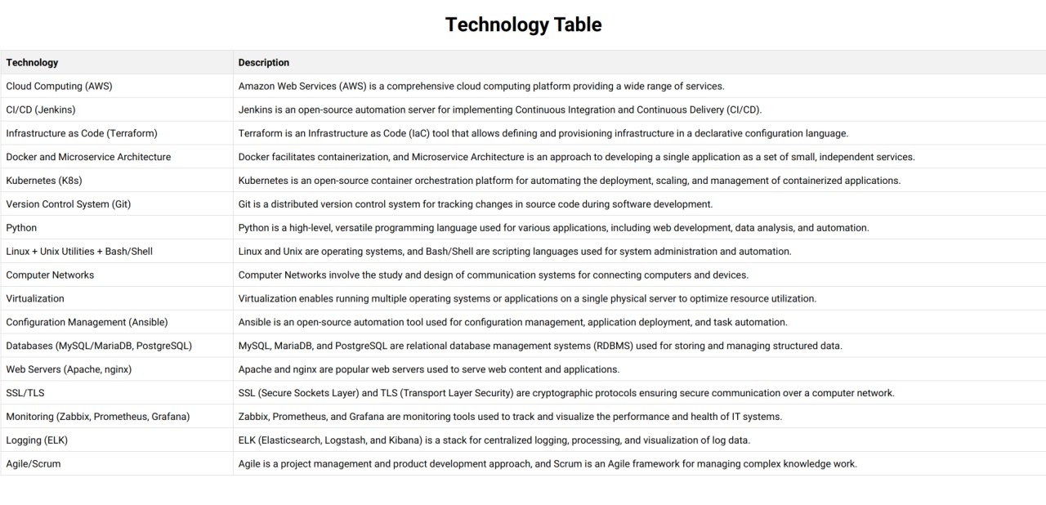
Application

Slide 9
apiVersion: apps/v1
kind: Deployment
metadata:
name: backend
namespace: react-nodejs-postgresql-app
spec:
replicas: 1
selector:
matchLabels:
app: backend
template:
metadata:
labels:
app: backend
spec:
containers:
- name: backend-container
image: gundenaf/backend:latest
ports:
- containerPort: 4000
---
apiVersion: v1
kind: Service
metadata:
name: backend-service
namespace: react-nodejs-postgresql-app
spec:
type: LoadBalancer
selector:
app: backend
ports:
- protocol: TCP
port: 4000
apiVersion: apps/v1
kind: Deployment
metadata:
name: db
namespace: react-nodejs-postgresql-app
spec:
replicas: 1
selector:
matchLabels:
app: db
template:
metadata:
labels:
app: db
spec:
containers:
- name: postgres
image: gundenaf/database:latest
env:
- name: POSTGRES_USER
value: your_username
- name: POSTGRES_PASSWORD
value: your_password
- name: POSTGRES_DB
value: your_database
---
apiVersion: v1
kind: Service
metadata:
name: db-service
namespace: react-nodejs-postgresql-app
spec:
type: LoadBalancer
selector:
app: db
ports:
- protocol: TCP
port: 5432
apiVersion: apps/v1
kind: Deployment
metadata:
name: frontend
namespace: react-nodejs-postgresql-app
spec:
replicas: 1
selector:
matchLabels:
app: frontend
template:
metadata:
labels:
app: frontend
spec:
containers:
- name: frontend-container
image: gundenaf/frontend:latest
ports:
- containerPort: 3000
---
apiVersion: v1
kind: Service
metadata:
name: frontend-service
namespace: react-nodejs-postgresql-app
spec:
type: LoadBalancer
selector:
app: frontend
ports:
- protocol: TCP
port: 3000

Slide 10
CI/CD Pipeline Stages Overview
Checkout
Objective: Retrieve the project source code from the GitHub repository.
Build Docker Images
Objective: Create Docker images for the frontend, backend, and database components.
Push to Docker Hub
Objective: Authenticate Docker with Docker Hub and push Docker images.
Deploy to Minikube
Objective: Deploy the application into a Minikube Kubernetes cluster.

Slide 11
pipeline {
agent { label 'jenkins-agent' }
environment {
DOCKERHUB_CREDENTIALS = credentials('docker-hub-credentials-id')
}
parameters {
string(name: 'DOCKERHUB_USERNAME', description: 'DockerHub Username')
string(name: 'MINIKUBE_HOST', description: 'Minikube Host IP')
string(name: 'MINIKUBE_PORT', description: 'Minikube Host Port')
}
stages {
stage('Checkout') {
steps {
script {
checkout([$class: 'GitSCM',
branches: [[name: '*/main']],
userRemoteConfigs: [[url: 'https://github.com/gundenaf/react-nodejs-postgresql-app.git']]])
}
}
}
stage('Build Docker Images') {
steps {
echo 'Building Docker images...'
// Build the Docker images for frontend, backend, and database
sh "sudo docker build -t $DOCKERHUB_USERNAME/frontend:latest ./frontend"
sh "sudo docker build -t $DOCKERHUB_USERNAME/backend:latest ./backend"
sh "sudo docker build -t $DOCKERHUB_USERNAME/database:latest ./database"
}
}
stage('Deploy to Minikube') {
steps {
script {
def minikubeHost = params.MINIKUBE_HOST
def minikubePort = params.MINIKUBE_PORT
def dockerhubUsername = params.DOCKERHUB_USERNAME
sshagent (credentials: ['minikube-vm-id']) {
sh "ssh -o StrictHostKeyChecking=no -p ${minikubePort} minikube@${minikubeHost} minikube stop"
sh "ssh -o StrictHostKeyChecking=no -p ${minikubePort} minikube@${minikubeHost} minikube delete"
sh "ssh -o StrictHostKeyChecking=no -p ${minikubePort} minikube@${minikubeHost} rm -rf TMS-homework"
sh "ssh -o StrictHostKeyChecking=no -p ${minikubePort} minikube@${minikubeHost} git clone https://github.com/gundenaf/TMS-homework.git"
sh "ssh -o StrictHostKeyChecking=no -p ${minikubePort} minikube@${minikubeHost} minikube start --listen-address='0.0.0.0'"
sh "ssh -o StrictHostKeyChecking=no -p ${minikubePort} minikube@${minikubeHost} docker pull ${dockerhubUsername}/frontend:latest"
sh "ssh -o StrictHostKeyChecking=no -p ${minikubePort} minikube@${minikubeHost} docker pull ${dockerhubUsername}/backend:latest"
sh "ssh -o StrictHostKeyChecking=no -p ${minikubePort} minikube@${minikubeHost} docker pull ${dockerhubUsername}/database:latest"
sh "ssh -o StrictHostKeyChecking=no -p ${minikubePort} minikube@${minikubeHost} kubectl apply -f TMS-homework/Thesis/k8s/namespaces/namespace.yml"
sh "ssh -o StrictHostKeyChecking=no -p ${minikubePort} minikube@${minikubeHost} kubectl apply -f TMS-homework/Thesis/k8s/networks/network.yml"
sh "ssh -o StrictHostKeyChecking=no -p ${minikubePort} minikube@${minikubeHost} kubectl apply -f TMS-homework/Thesis/k8s/manifests/db-deployment.yml"
sh "ssh -o StrictHostKeyChecking=no -p ${minikubePort} minikube@${minikubeHost} kubectl apply -f TMS-homework/Thesis/k8s/manifests/backend-deployment.yml"
sh "ssh -o StrictHostKeyChecking=no -p ${minikubePort} minikube@${minikubeHost} kubectl apply -f TMS-homework/Thesis/k8s/manifests/frontend-deployment.yml"
sh "ssh -o StrictHostKeyChecking=no -p ${minikubePort} minikube@${minikubeHost} kubectl wait --for=condition=Ready pod --all -n react-nodejs-postgresql-app --timeout=300s"
sh "ssh -o StrictHostKeyChecking=no -p ${minikubePort} minikube@${minikubeHost} 'nohup kubectl port-forward --address 0.0.0.0 service/backend-service --namespace=react-nodejs-postgresql-app 4000:4000 > /dev/null 2>&1 &'"
sh "ssh -o StrictHostKeyChecking=no -p ${minikubePort} minikube@${minikubeHost} 'nohup kubectl port-forward --address 0.0.0.0 service/frontend-service --namespace=react-nodejs-postgresql-app 3000:3000 > /dev/null 2>&1 &'"
}
}
}
}

Slide 12
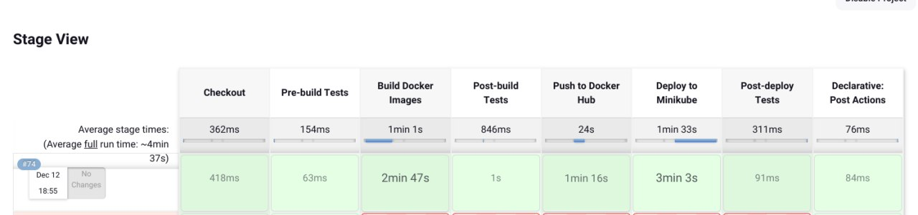
CI/CD Pipeline Stage View

Slide 13
Conclusion
This project showcases the integration of various technologies to achieve a streamlined CI/CD process for a React + NodeJS application. The use of Terraform, Jenkins, and Kubernetes illustrates a robust approach to infrastructure management and application deployment.

